Slide 1
Space Physics Data Analysis
PHYS 384: ST: Space Physics
Spring 2021

Slide 2
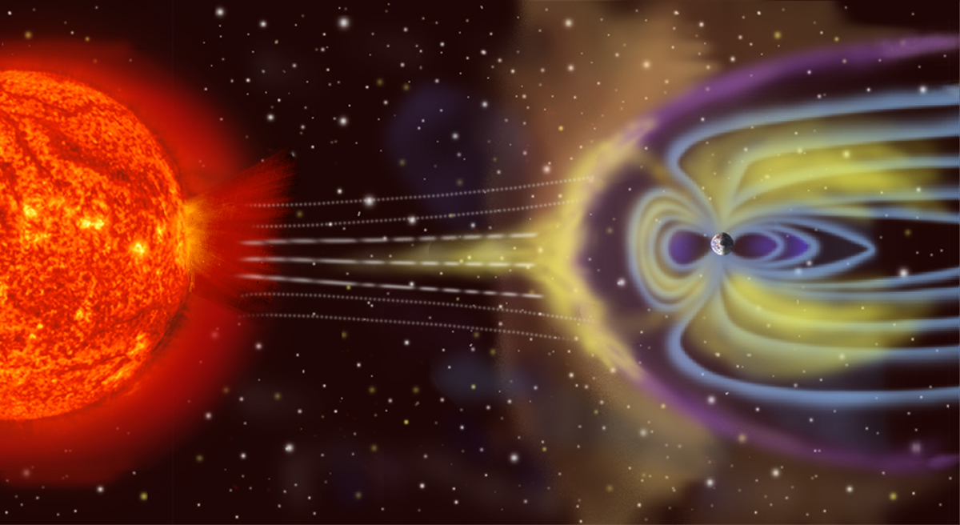
The Geospace System
Atmosphere & Ionosphere
Sun
Magnetosphere
Solar Wind
Interplanetary Magnetic Field
Image Credit: NASA

Slide 3
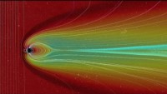
NASA: Comparing CMEs with Model Runs
https://www.youtube.com/watch?v=cLLq6plMjU0
Notes:
Comparative Magnetospheres: A Noteworthy Coronal Mass Ejection
In an effort to understand and predict the impact of space weather events on Earth, the Community-Coordinated Modeling Center (CCMC) at NASA Goddard Space Flight Center, routinely runs computer models of the many historical events. The output from these models are then compared to actual data to determine ways to improve the model, and therefore forecasts of the impacts of future space weather events. The visualization presented here is a CCMC run of a BATS-R-US model simulating the impact of a coronal mass ejection (CME) on Earth's magnetosphere. Here, lines are used to represent the 'flow direction' of the magnetic field of the solar wind impacting Earth, as well as the effects on Earth's geomagnetic field. A 'cut-plane' through the data illustrates the changes in the particle density in the solar wind and magnetosphere. The color of the data represents a logarithmic scaling of density, with red as the highest (1000 particles per cubic centimeter) down to blue (0.01 particles per cubic centimeter). In this simulation, each frame of the movie corresponds to two minutes of real time. This model run is based on a solar event in mid-December of 2006, when the Sun erupted with a bright flare and coronal mass ejection (CME) that launched particles Earthward. While not the brightest or largest event observed, its impact on Earth was substantial, requiring some effort to protect satellites (for more information see http://www.esa.int/Our_Activities/Ope...). In the movie, we see vertical field lines of magnetic field carried by the solar wind, coming in from the left. As this field, and the plasma carrying it, strike Earth's magnetic field, they bend and reconnect, around the Earth. Some field lines actually reconnect to the polar regions of the Earth, providing a ready flow-path for particles to reach the ionosphere and generate aurora. This interaction between the solar wind and the plasma trapped in Earth's magnetosphere also creates a density enhancement between Earth and the solar wind helping to shield Earth from some of the effects. A lower density wake forms behind Earth (the blue region). There is a circular 'hole' around the Earth which is a gap in the model. Visualizer: Tom Bridgman (lead) For more information or to download this public domain video, go to https://svs.gsfc.nasa.gov/4188#19749.
SHOW LESS

Slide 4
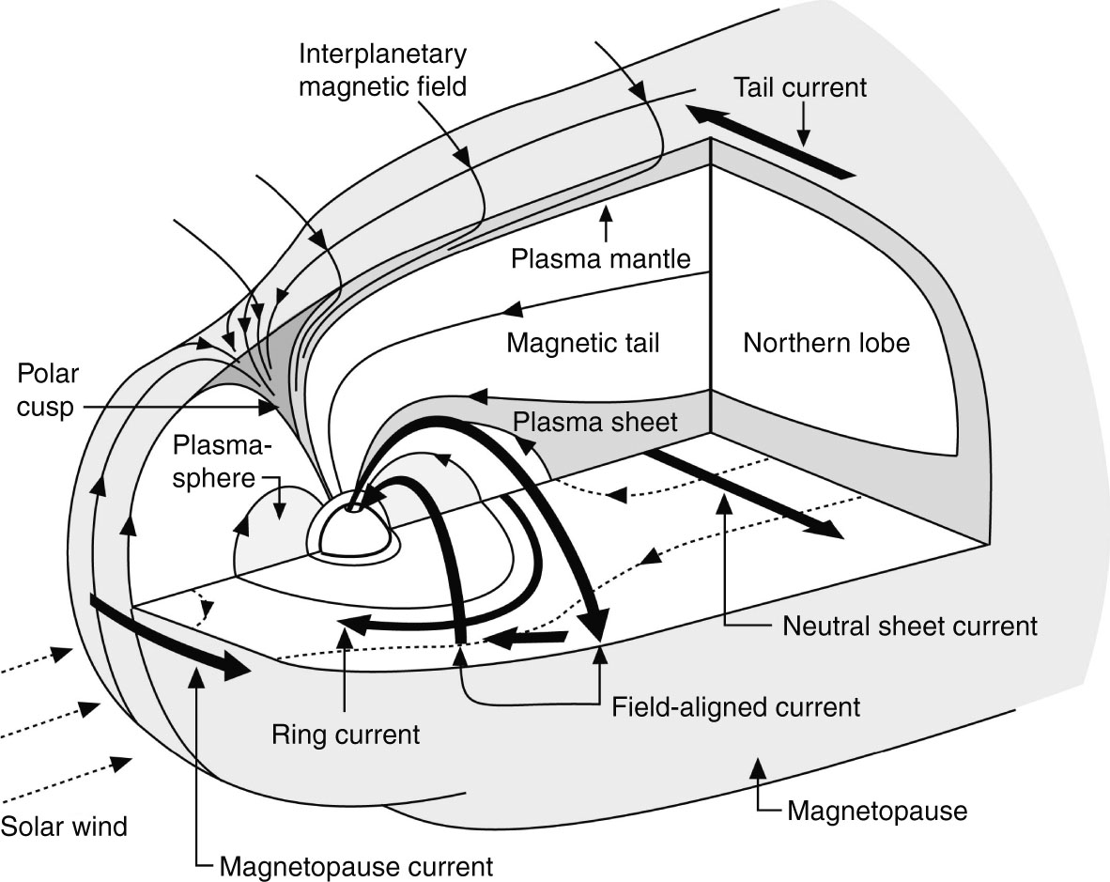
Earth’s Magnetosphere

Slide 5
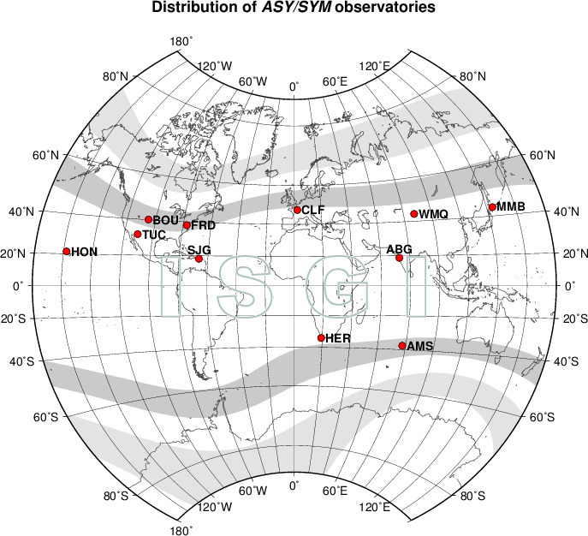
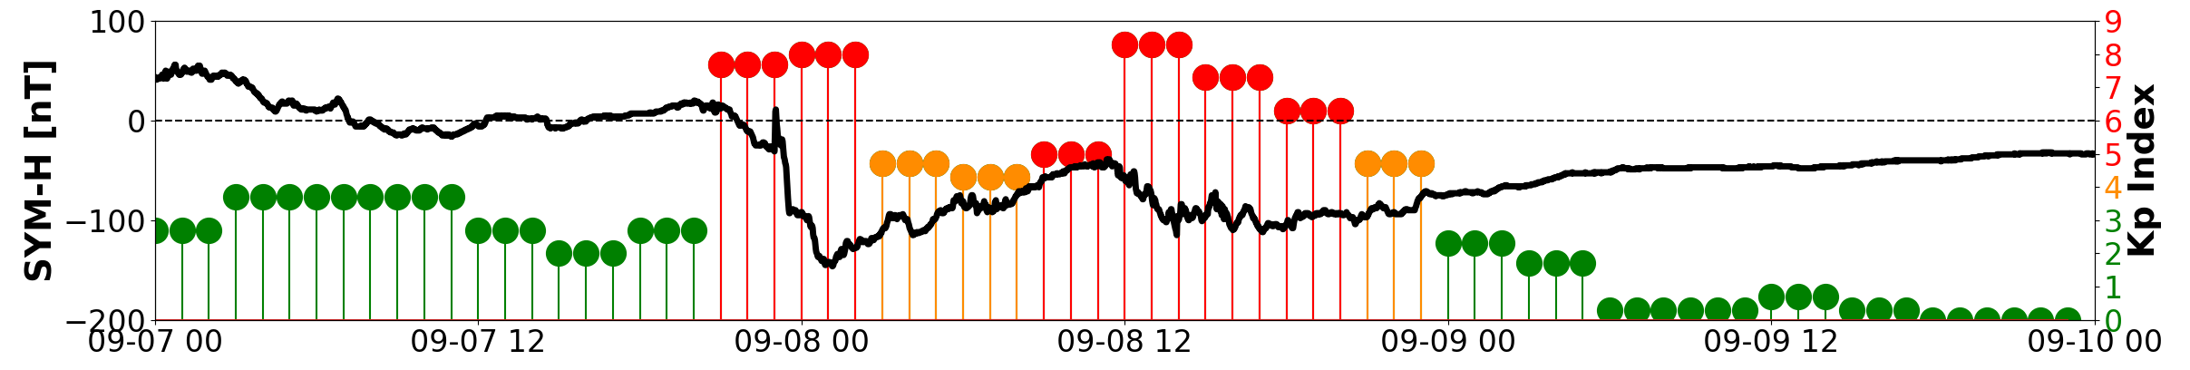
Geomagnetic Storms
Sym-H Magnetometers
Fast CMEs and CIR/HSSs can lead to geomagnetic storms.
Defined by negative excursion in
Dst (Disturbance Storm Time Index)
Sym-H Indices (High resolution version of DST)
http://isgi.unistra.fr/indices_asy.php
Notes:
Figure: http://isgi.unistra.fr/indices_asy.php
Retrieved 12 Sept 2018

Slide 6
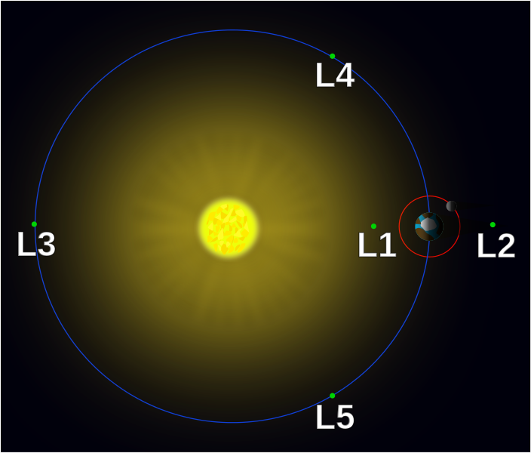
Solar Wind Measurement
The Solar Wind is measured by interplanetary spacecraft at the Lagrange (L1) point.
L1 is about 1.5 million kilometers from Earth towards the Sun.
This is still roughly 1 AU (150 million km) from the Sun!
Lagrange points in the Sun–Earth system (not to scale) – a small object at any one of the five points will hold its relative position.
https://en.wikipedia.org/wiki/Lagrange_point

Slide 7
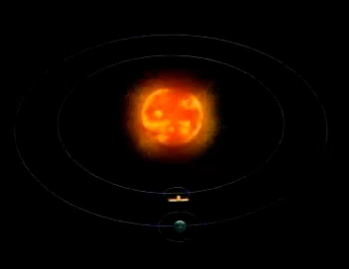
SOHO Orbit Around L1 Point
SOHO's orbit around the Lagrangian L1 point and the Sun
[NASA]

